Slide 1
Winner Winner Chicken Dinner
Peyton Fosnough

Slide 2

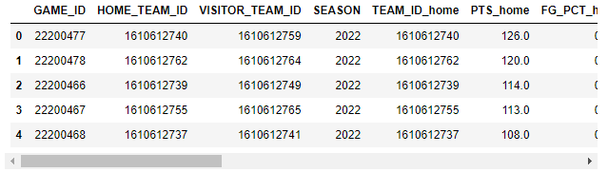
Overview
Predicting NBA game results
26,652 samples and 19 columns of data
6 columns needed removal

Slide 3
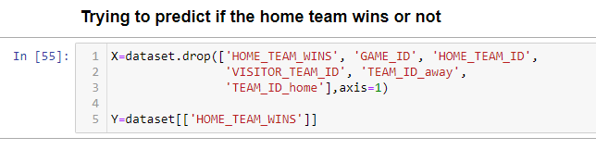
Dropping columns & setting Y

Slide 4
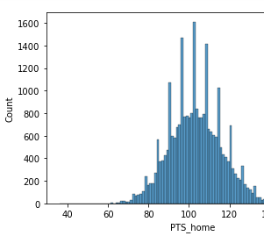
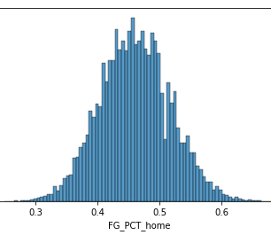
Preparing the data
There were 12 columns with missing data
All 12 were normally distributed, so the mean was used

Slide 5
Splitting the data
Used the Logistic Regression library from sklearn
Completed 3 experiments with the following splits:
60/40
80/20
90/10

Slide 6
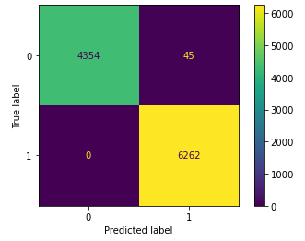
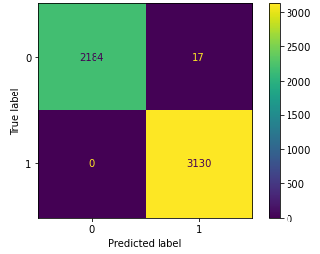

Results
Experiment 1: 100% Accuracy
Experiment 2: 100% Accuracy
Experiment 3: 100% Accuracy

Slide 7
Summary
Can we predict if the home team will win/lose based on stats?
The model was accurate and effectively predicted the outcome
There was consistency throughout different train/test ratios

